Slide 1
The Semantics of Bayesian Networks
By
22WH1A6629 n.kEERTHI
22WH1A6631 b.Rishita Reddy

Slide 2
Semantic networks in ai
Semantic Networks are alternative of predicate logic for knowledge representation.
In this networks we can represent our knowledge in the form of graphical notations.
This network consists of nodes representing objects and arcs which describe the relationship between those objects.
Semantic networks are easy to understand and can be easily extended.

Slide 3
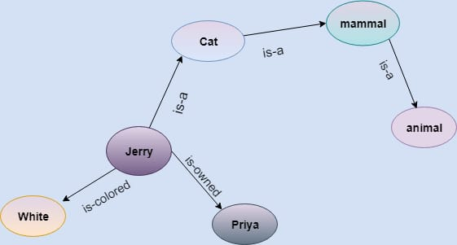
Example
Statements:
Jerry is a cat.
Jerry is a mammal.
Jerry is owned by keerthi.
Jerry is white colored.
All mammals are animal.

Slide 4
Bayesian Networks In ai
Definition: It defines probabilistic independencies and dependencies among the variables in the network
It is a probabilistic graphical model which represents a set of variables and their conditional dependencies using a Directed acyclic graph (DAG).
It is built from Probability distribution.
It consist of DAG and Table of Conditional Probabilities.
Node: Corresponds to a Random Variable which may be Continuous and discrete
Arc/Directed arrows: Represents Casual relationship or conditional probabilities among the random variables.

Slide 5
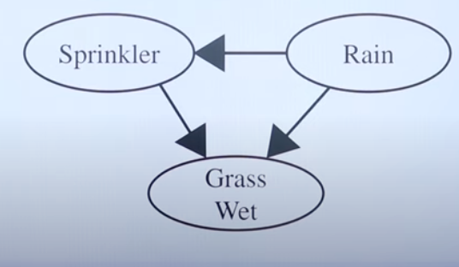
EXAMPLE
RAIN
SPRINKLER
R | ~R
0.2 | 0.8
R | S | ~S
~R | 0.4 | 0.6
R | 0.01 | 0.99
P(W,S,R)=P(W/S,R)*P(S/R)*P(R)
=0.99*0.01*0.2
=0.00198
P(W,~S,~R)=P(W/~S,~R)*P(~S/~R)*P(~R)
=0*0.6*0.8
=0
GRASS WET
S | R | W | ~W
~S | ~R | 0.0 | 1.0
~S | R | 0.8 | 0.2
S | ~R | 0.9 | 0.1
S | R | 0.99 | 0.01

